Slide 1
History of Text Summarization
Most cited work was that of Luhn’s from 1958, he proposed that the frequency of a word is a useful measure.
Baxendale said sentence position is important as well, he examined 200 documents to find the topic sentence was the first one in 85% cases.
From 1990’s Machine Learning techniques in NLP started being used that used statistical techniques like Naive-Bayes.
Today the focus is to use deep learning techniques and natural language processing in order to get computers to understand language. Since computers lack human knowledge and language capability, it makes automatic text summarization a very difficult and non-trivial task.

Slide 2
Extractive Methods - Weighted Frequency
This method is based on the frequency of important words occurring in the text. Stopwords is a list of words that are generally omitted.
A sequence of steps for implementing this algorithm are:-
1. Convert paragraph into sentences.
2. Ignore stop words, numbers and punctuations.
3. Tokenize
4. Build hashmap of words and frequencies. Calculate by dividing frequency of each word by most recurrent word in the text.
5. Add the weighted frequencies and arrange descending order.
6. Choose the top 2 to 3 sentences to generate summary.

Slide 3
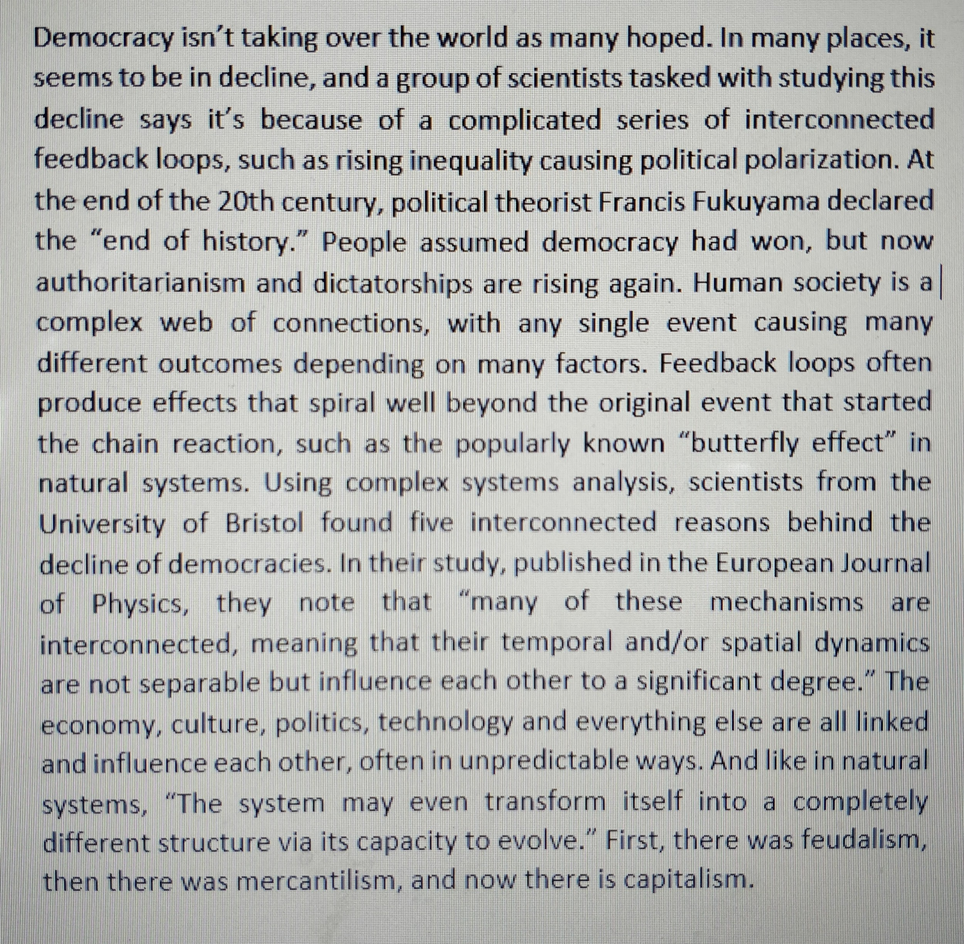
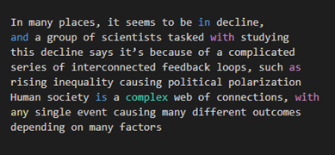
Sample:- Summary:-
Drawbacks:-
No semantic grasping
There will be a disconnect in the summary as something referenced in other sentences will not be known.

Slide 4
Word Probability Method
This algorithm proceeds almost like the previous one except here the probability of a word w is determined as the number of occurrences of the word, f (w), divided by the number of all words in the input:-
P(w) = f (w)/ N
We use SumBasic system which uses only the word probability approach to determine sentence importance. For each sentence, in the input, it assigns a weight equal to the average probability of the words in the sentence.
In the next step, it picks the best scoring sentence that contains the highest probability word.
This is modified according to desired length of the summary.

Slide 5
Future Implementation
After implementing extractive algorithms we’ll be focusing on abstractive techniques. Since these require building a model and training it, it’s considerably more challenging and produces better results:-
Seq2Seq model:- This is a model based on Long Short Term Memory which is an artificial recurrent neural network used in deep learning. It can be used on any problem which requires sequential information. We use Encoder-Decoder architecture here which is used to solve the sequence-to-sequence problems where the input and output sequences are of different lengths. An Encoder Long Short Term Memory model (LSTM) reads the entire input sequence and processes the information and captures the contextual information present in the input sequence. The decoder is trained to predict the next word in the sequence given the previous word.

Slide 6
Conclusion
Text Summarization is a vast field with active research going on, especially in the field of abstractive text summarization using neural networks.
Our attempt is to research and implement the various algorithms currently devised in this field, and try to fine tune them further. We’ll also be implementing an RNN model, training it and comparing the results obtained with the extractive methods.

Slide 7
Bibliography
Text Summarization Techniques: A Brief Survey - Paper from University of Georgia
https://towardsdatascience.com/
https://medium.com/
https://www.analyticsvidhya.com/
A Survey on Automatic Text Summarization - Paper from CMU

